Slide 1
Linked Lists, Stacks, and Queues
COMP 272/400C:
Data Structures II
Prof. Silva
These slides were prepared by Prof. Silva adapting the slides from Data Structures & Algorithms in Java (Goodrich et al.) and Data Structures and Algorithm Analysis in Java (Weiss)

Slide 2

Linked List
Consists of a sequence of nodes, each containing arbitrary data fields and one or two references ("links") pointing to the next and/or previous nodes.
Sequential access to elements
No limitation on number of elements
Singly linked list, doubly linked list and circularly linked list

Slide 3
Singly Linked List
Consisting of a sequence of nodes
Each node stores
element
link to the next node
Head and tail
Can only be traversed in one direction
next
elem
node
head
tail
∅
A
B
C
D

Slide 4
The Node Class for List Nodes
public class Node {
// Instance variables:
public Object element;
public Node next; /*self referential structure*/
/** Creates a node with the given element and next node. */
public Node(Object e, Node n) {
element = e;
next = n;
}
}
public class SLinkedList {
protected Node head;
protected Node tail;
protected long size;
……
}

Slide 5
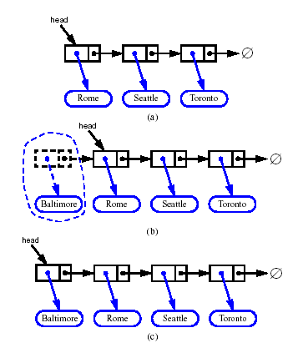
Inserting at the Head
addFirst(v)
v.next = head;
head = v;
size = size + 1;
v

Slide 6
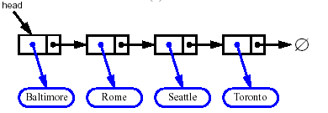
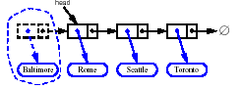
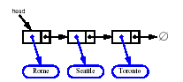
Removing at the Head
removeFirst()
if head = NULL then
indicate an error
Node t = head;
head = head.next;
t.next = null;
size = size – 1;

Slide 7
Doubly Linked List
Consist of a sequence of nodes
Each node stores:
element
link to the previous node
link to the next node
Special header and trailer nodes
Can be traversed in both direction
prev
next
elem
node
header
nodes
trailer
elements

Slide 8
Doubly Linked List
public class DNode {
// Instance variables:
public Object element;
public DNode next, prev;
/** Creates a node with the given element and next node. */
public DNode(Object e, DNode p, DNode n) {
element = e;
prev = p
next = n;
}
}
public class DLinkedList {
protected DNode header, trailer;
protected long size;
……
}

Slide 9
Insertion Algorithm
Algorithm addAfter(p,v)://add node v after node p
DNode q = p.next;
v.prev = p //link v to its predecessor
v.next = q //link v to its successor
q.prev = v
p.next = v
p
A
B
C

Slide 10
Deletion
Algorithm remove(p):
p.prev.next = p.next // linking out p
p.next.prev = p.prev
p.prev = null //invalidating the node p
p.next = null
We visualize remove(p), where p = last()
p
A
B
C
D
A
B
C
p
D
A
B
C

Slide 11
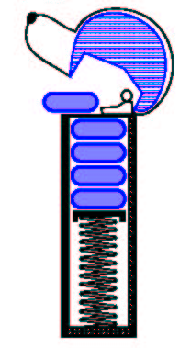
The Stack ADT
The Stack ADT stores arbitrary objects
Insertions and deletions follow the last-in first-out scheme
Think of a spring-loaded plate dispenser
Main stack operations:
push(object): inserts an element
object pop(): removes and returns the last inserted element
Auxiliary stack operations:
object top(): returns the last inserted element without removing it
integer size(): returns the number of elements stored
boolean isEmpty(): indicates whether no elements are stored

Slide 12
Stack Interface in Java
public interface Stack<E> {
public int size();
public boolean isEmpty();
public E top() throws EmptyStackException;
public void push(E element);
public E pop() throws EmptyStackException; }
Java interface corresponding to our Stack ADT
Requires the definition of class EmptyStackException
Different from the built-in Java class java.util.Stack

Slide 13
Applications of Stacks
Direct applications
Page-visited history in a Web browser
Undo sequence in a text editor
Chain of method calls in the Java Virtual Machine
Indirect applications
Auxiliary data structure for algorithms
Component of other data structures

Slide 14
Array-based Stack
A simple way of implementing the Stack ADT uses an array
We add elements from left to right
A variable keeps track of the index of the top element
Algorithm size()
return t + 1
Algorithm pop()
if isEmpty() then
throw EmptyStackException
else
t ← t − 1
return S[t + 1]
…
S
0
1
2
t

Slide 15
Array-based Stack (cont.)
The array storing the stack elements may become full
A push operation will then throw a FullStackException
Limitation of the array-based implementation
Not intrinsic to the Stack ADT
Algorithm push(o)
if t = S.length − 1 then
throw FullStackException
else
t ← t + 1
S[t] ← o
…
S
0
1
2
t

Slide 16
Array-based Stack in Java
public class ArrayStack<E> implements Stack<E> {
// holds the stack elements private E S[ ];
// index to top element private int top = -1;
// constructor public ArrayStack(int capacity) { S = (E[ ]) new Object[capacity]); }
public E pop() throws EmptyStackException { if isEmpty() throw new EmptyStackException (“Empty stack: cannot pop”); E temp = S[top]; // facilitate garbage collection: S[top] = null; top = top – 1; return temp; }
… (other methods of Stack interface)

Slide 17
Example use in Java
public class Tester {
// … other methods public intReverse(Integer a[ ]) { Stack<Integer> s; s = new ArrayStack<Integer>();
… (code to reverse array a) … }
public floatReverse(Float f[ ]) { Stack<Float> s; s = new ArrayStack<Float>();
… (code to reverse array f) … }

Slide 18
Parentheses Matching
Each “(”, “{”, or “[” must be paired with a matching “)”, “}”, or “[”
correct: ( )(( )){([( )])}
correct: ((( )( ))){([( )])}
incorrect: )(( )){([( )])}
incorrect: ({[ ])}
incorrect: (

Slide 19
Parentheses Matching Algorithm
Algorithm ParenMatch(X,n):
Input: An array X of n tokens, each of which is either a grouping symbol, a
variable, an arithmetic operator, or a number
Output: true if and only if all the grouping symbols in X match
Let S be an empty stack
for i=0 to n-1 do
if X[i] is an opening grouping symbol then
S.push(X[i])
else if X[i] is a closing grouping symbol then
if S.isEmpty() then
return false {nothing to match with}
if S.pop() does not match the type of X[i] then
return false {wrong type}
if S.isEmpty() then
return true {every symbol matched}
else return false {some symbols were never matched}

Slide 20
The Queue ADT
The Queue ADT stores arbitrary objects
Insertions and deletions follow the first-in first-out scheme
Insertions are at the rear of the queue and removals are at the front of the queue
Main queue operations:
enqueue(object): inserts an element at the end of the queue
object dequeue(): removes and returns the element at the front of the queue
Auxiliary queue operations:
object front(): returns the element at the front without removing it
integer size(): returns the number of elements stored
boolean isEmpty(): indicates whether no elements are stored
Exceptions
Attempting the execution of dequeue or front on an empty queue throws an EmptyQueueException

Slide 21
Example
Operation Output Q
enqueue(5) – (5)
enqueue(3) – (5, 3)
dequeue() 5 (3)
enqueue(7) – (3, 7)
dequeue() 3 (7)
front() 7 (7)
dequeue() 7 ()
dequeue() “error” ()
isEmpty() true ()
enqueue(9) – (9)
enqueue(7) – (9, 7)
size() 2 (9, 7)
enqueue(3) – (9, 7, 3)
enqueue(5) – (9, 7, 3, 5)
dequeue() 9 (7, 3, 5)

Slide 22
Applications of Queues
Direct applications
Waiting lists, bureaucracy
Access to shared resources (e.g., printer)
Multiprogramming
Indirect applications
Auxiliary data structure for algorithms
Component of other data structures

Slide 23
Array-based Queue
Use an array of size N in a circular fashion
Two variables keep track of the front and rear
f index of the front element
r index immediately past the rear element
Array location r is kept empty
normal configuration
Q
0
1
2
f
r
wrapped-around configuration
Q
0
1
2
r
f

Slide 24
Queue Operations
We use the modulo operator (remainder of division)
Algorithm size()
return (N − f + r) mod N
Algorithm isEmpty()
return (f = r)
Q
0
1
2
f
r
Q
0
1
2
r
f

Slide 25
Queue Operations (cont.)
Operation enqueue throws an exception if the array is full
This exception is implementation-dependent
Algorithm enqueue(o)
if size() = N − 1 then
throw FullQueueException
else
Q[r] ← o
r ← (r + 1) mod N
Q
0
1
2
f
r
Q
0
1
2
r
f

Slide 26
Queue Operations (cont.)
Operation dequeue throws an exception if the queue is empty
This exception is specified in the queue ADT
Algorithm dequeue()
if isEmpty() then
throw EmptyQueueException
else
o ← Q[f]
f ← (f + 1) mod N
return o
Q
0
1
2
f
r
Q
0
1
2
r
f

Slide 27
Queue Interface in Java
public interface Queue<E> {
public int size();
public boolean isEmpty();
public E front() throws EmptyQueueException;
public void enqueue(E element);
public E dequeue() throws EmptyQueueException; }
Java interface corresponding to our Queue ADT
Requires the definition of class EmptyQueueException
No directly equivalent built-in Java class
Most similar class:
Interface: Queue
Class: LinkedList
enqueue(e) → offer(e)
dequeue() → poll()
front() → peek()

Slide 28
Exercise: Reverse a queue
Algorithm ReverseQueue(Q)
Input: queue Q
Output: queue Q in reverse order
S is an empty stack
while (! Q.isEmpty()) do
S.push(Q.dequeue())
while (! S.isEmpty()) do
Q.enqueue(S.pop())

